Slide 1
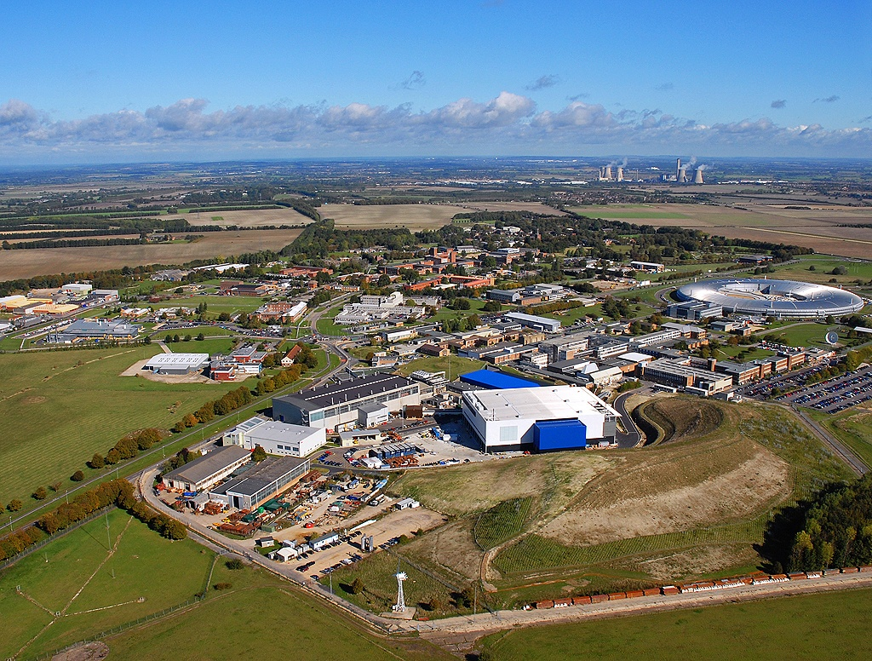
Status of the ISIS Digital LLRF Systems
Andy Seville
LLRF Workshop 2025

Slide 2
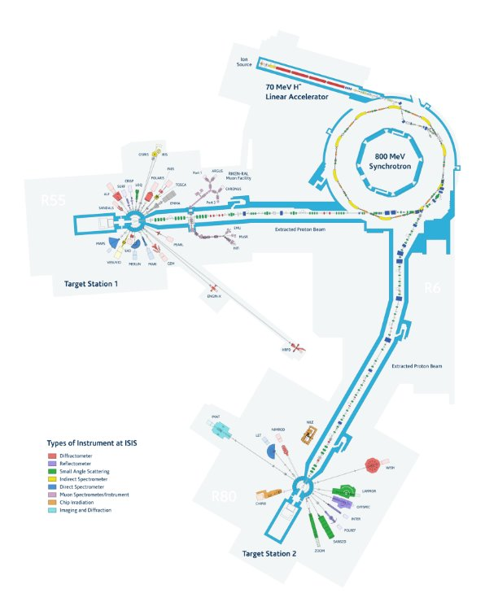
RF Systems in ISIS
ISIS H⁻ Injector
202.5 MHz in RFQ
202.5 MHz LINAC: 4 DTL tanks
- Frequency determined by available technology when built (1950s)
ISIS Proton RCS
1.3 – 3.1 MHz in six H=2 (1RF) cavities
2.6 – 6.2 MHz in four H=4 (2RF) cavities
800MeV Protons fed to 2 Target Stations
40Hz to TS1
10Hz to TS2

Slide 3
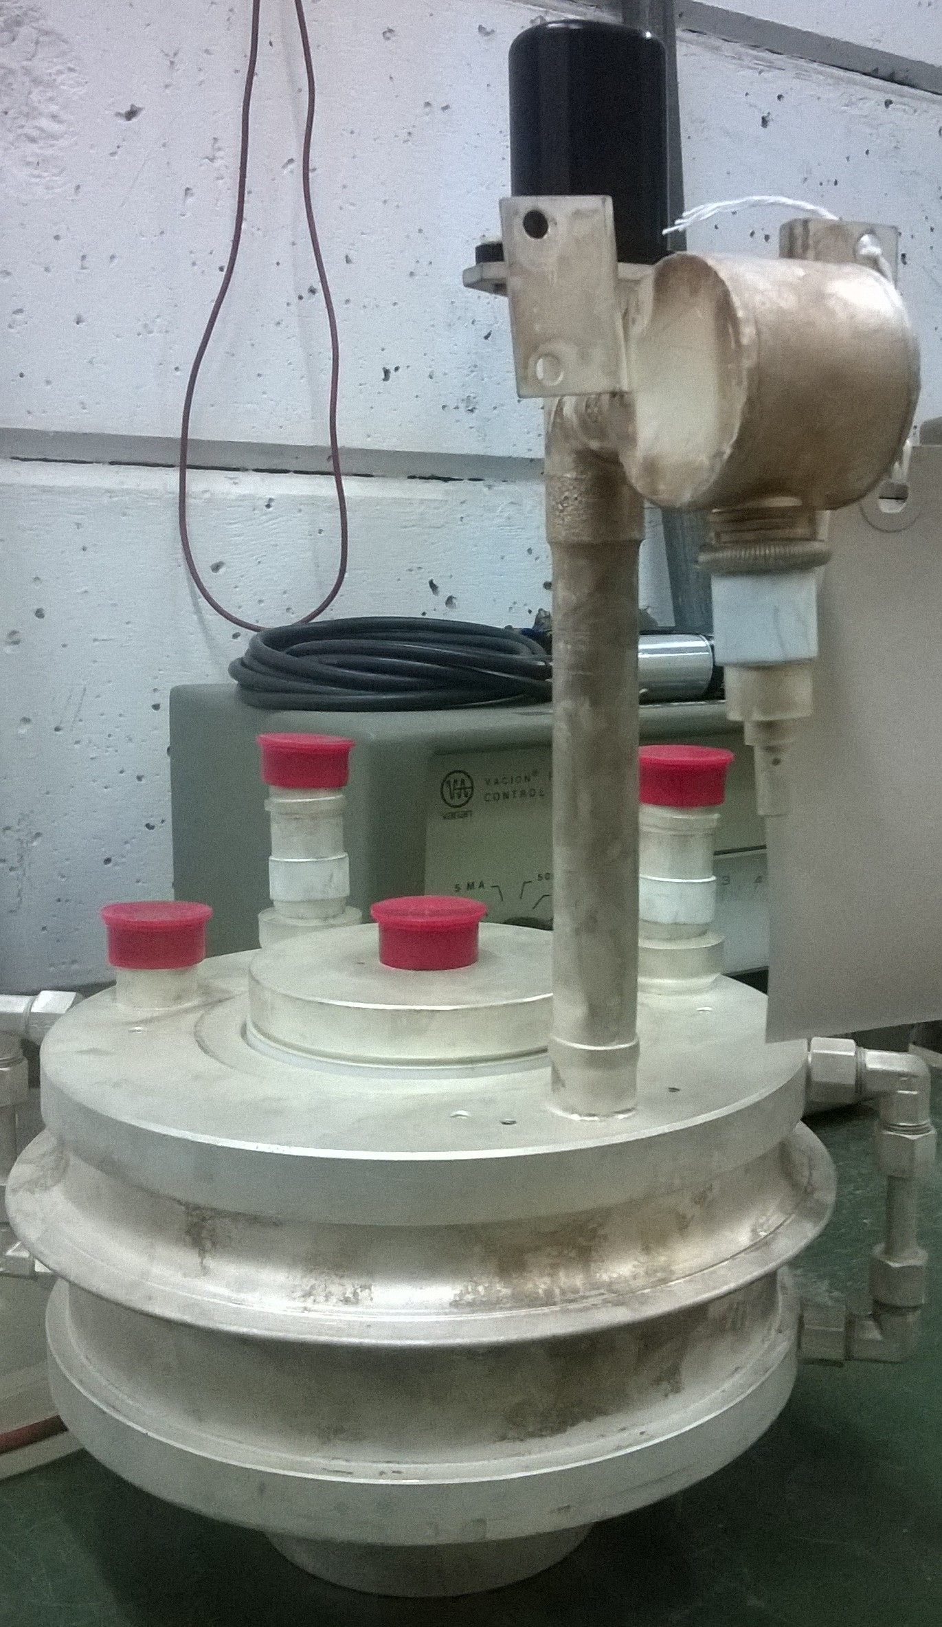
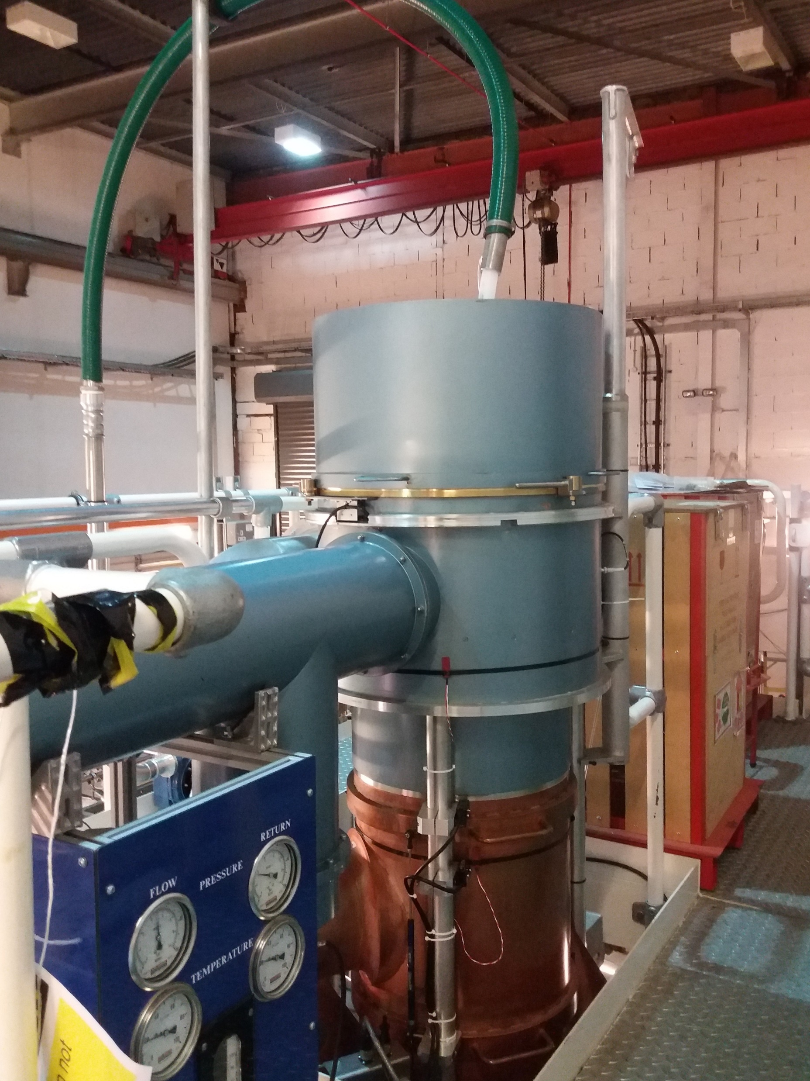
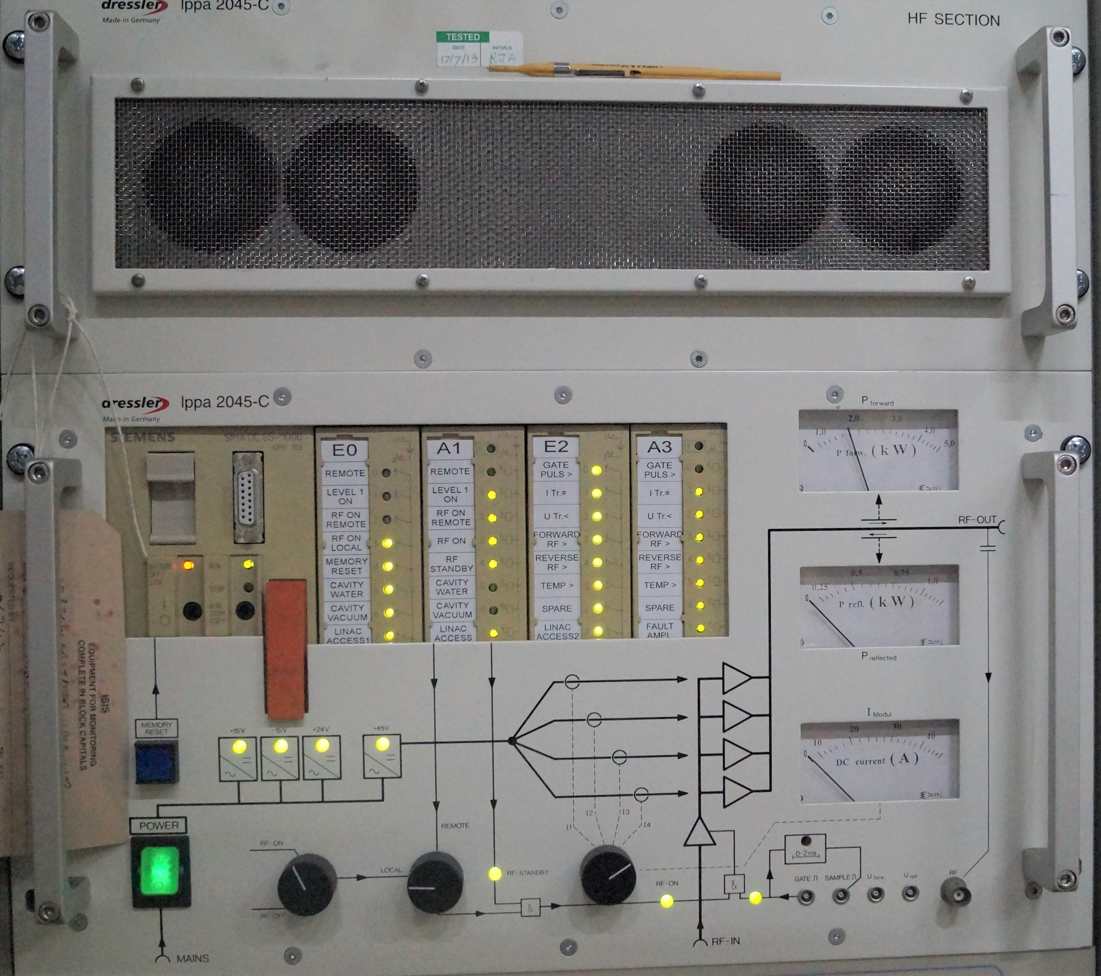
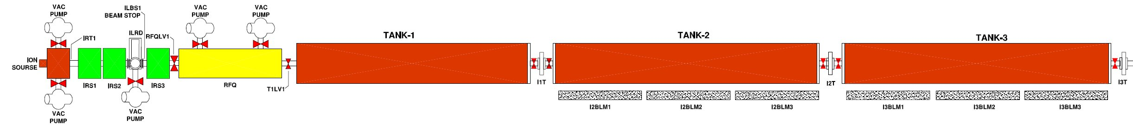
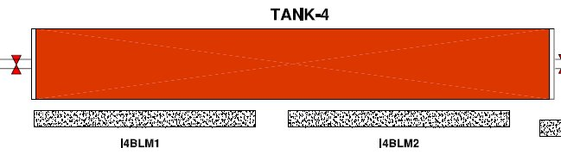
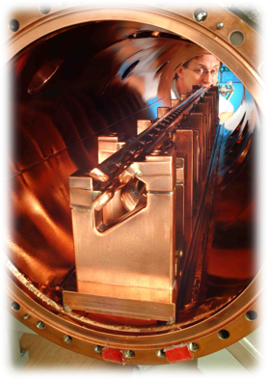
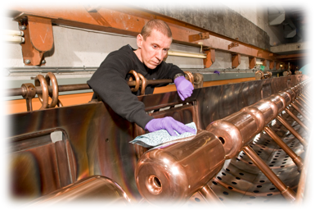
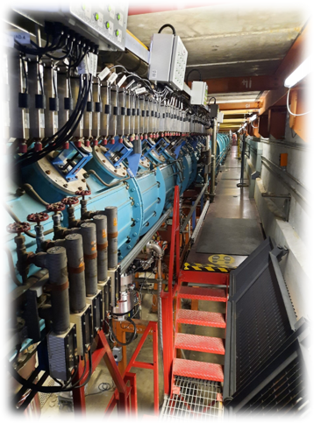

ISIS ${\text{H}}^{\text{−}}$ LINAC RF
Burle 4616
Tetrode (200kW)
Thales TH116
Triode (2MW)
Dressler
SSA 4.5kW
LINAC Tanks (Modulators)
35keV
665keV
9.9MeV
30.4MeV
49.7MeV
70.4MeV

Slide 4
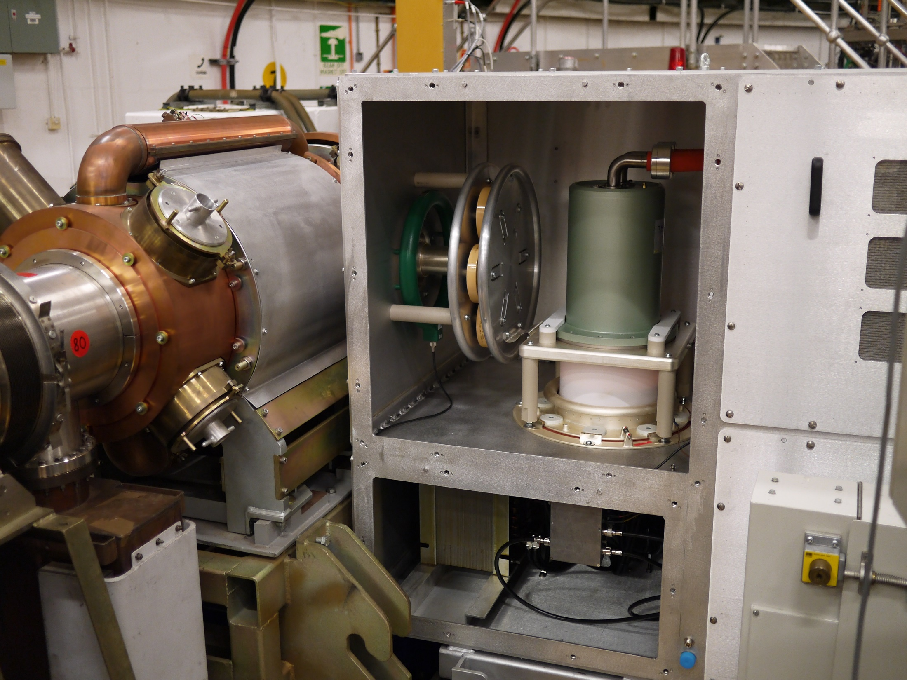
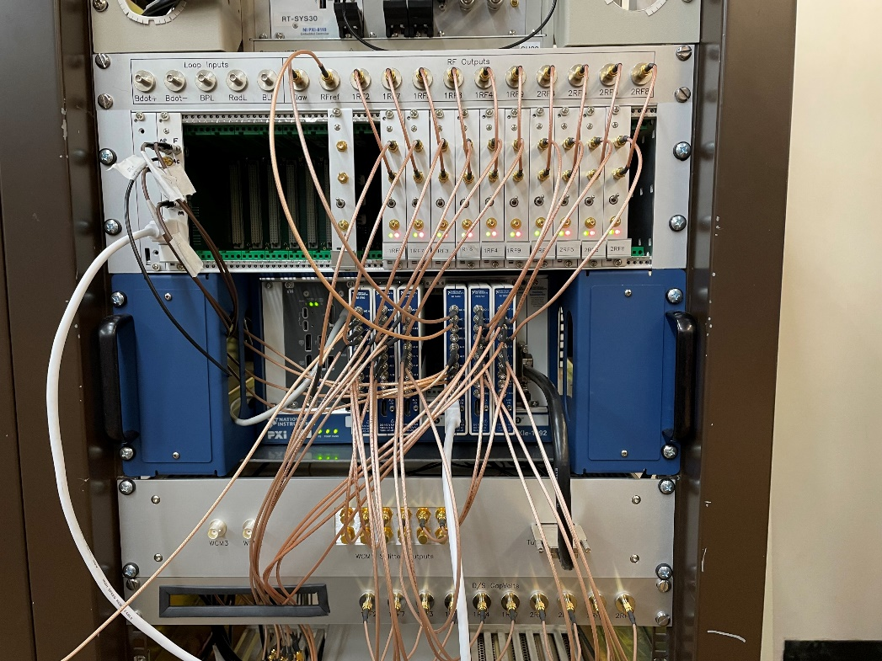
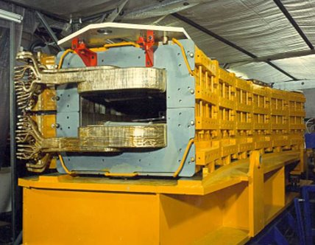
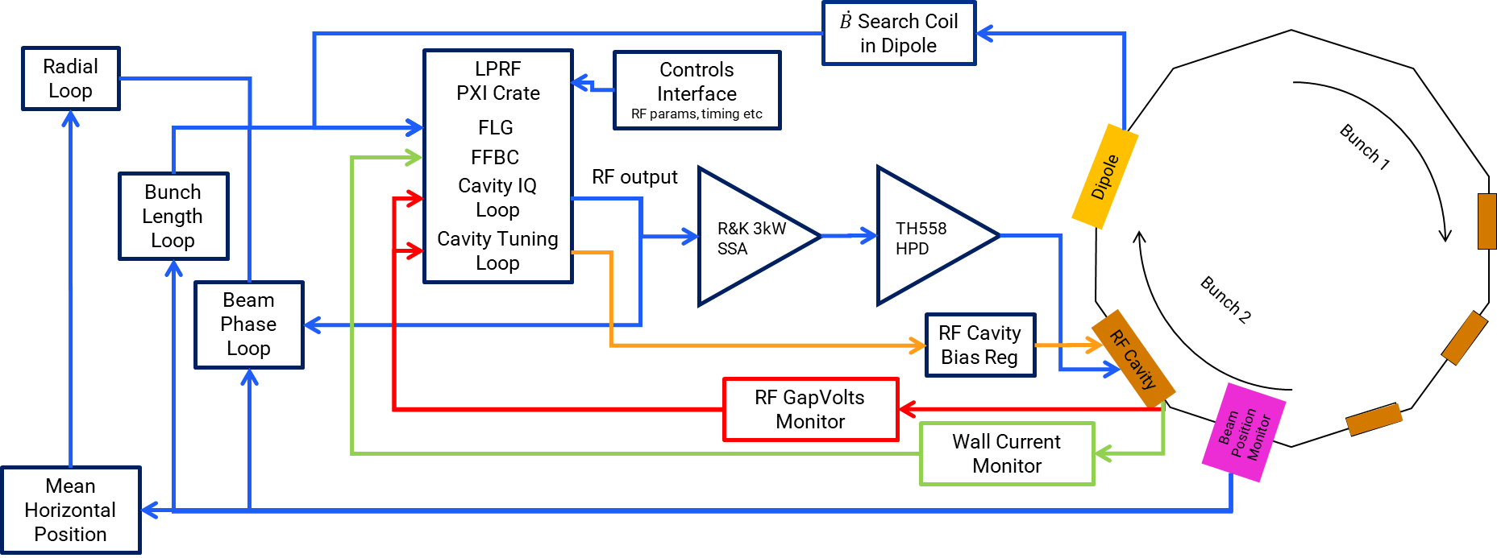
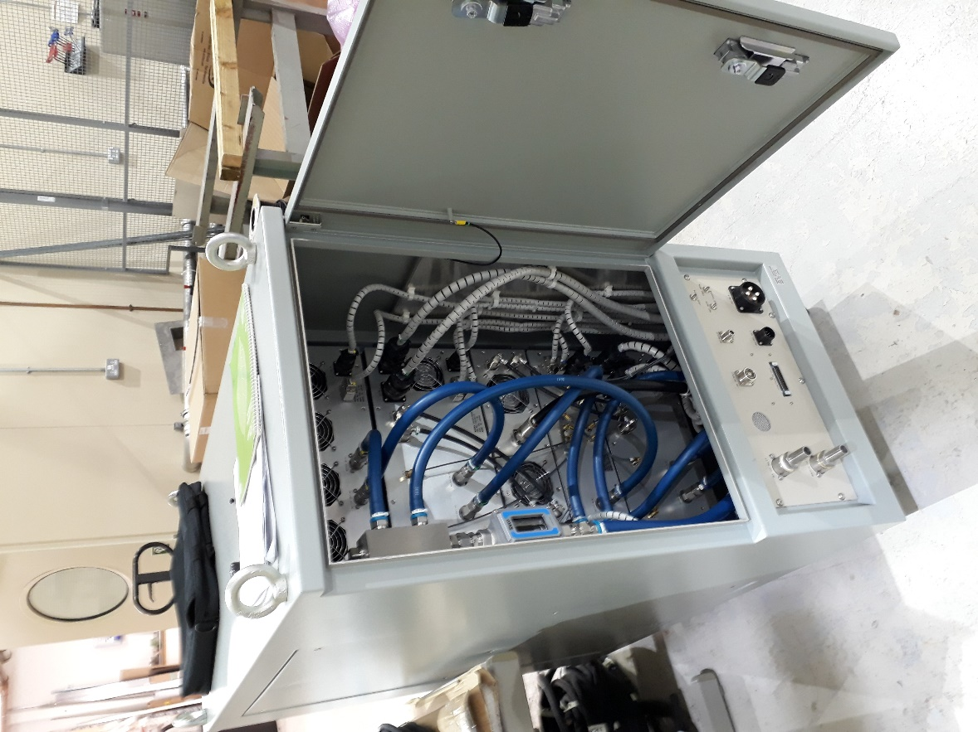
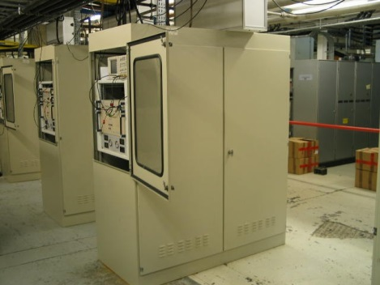
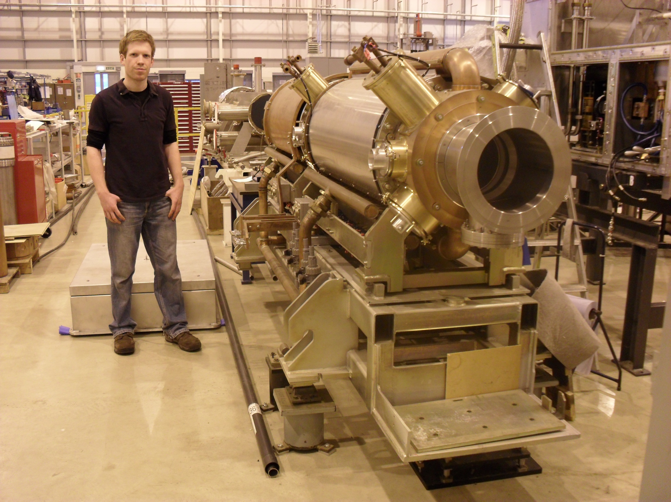
Synchrotron RF System

Slide 5
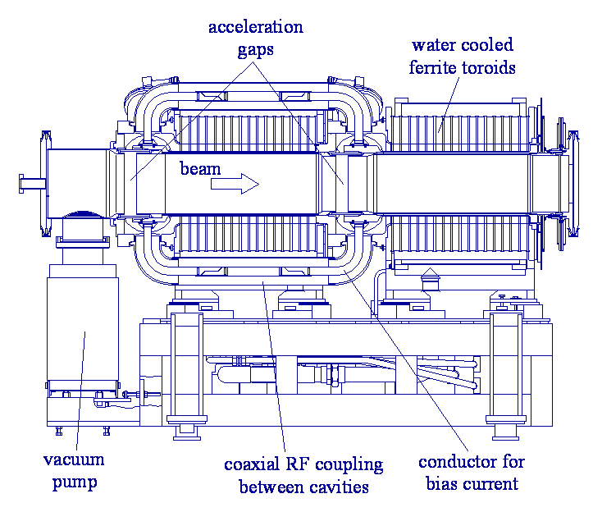
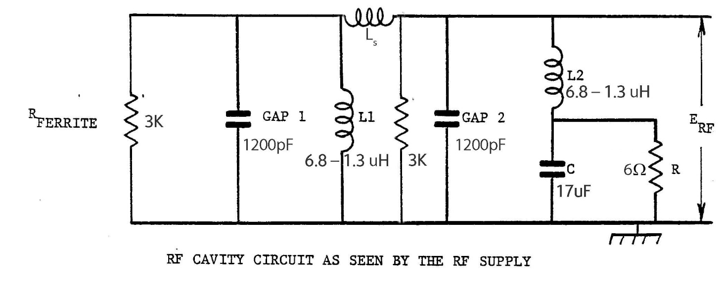
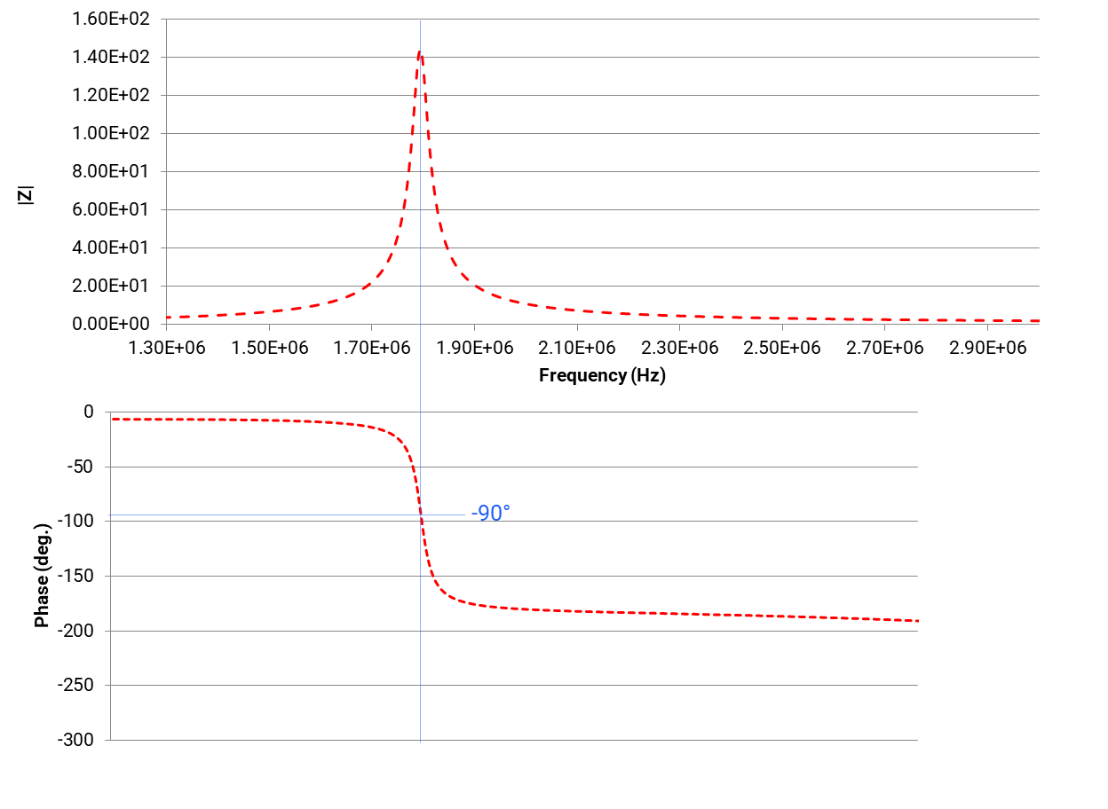
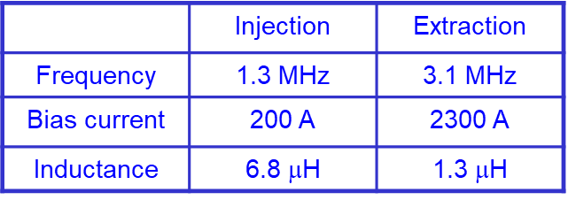
Synchrotron RF Cavity
Q~100
RF cavity resonant frequency swept by changing bias current through the Ferrite during 10ms Acceleration
Cavity phase response is used to keep cavity on tune by mapping phase error to a cavity bias current correction
Originally used phase difference from Tetrode Grid Volts - Gap Volts
Until recently replaced Grid Volts by a delayed copy of the Digital loop RF output
Now uses digitally generated Q error signal summed with tuning Feedforward (Cavtune)

Slide 6
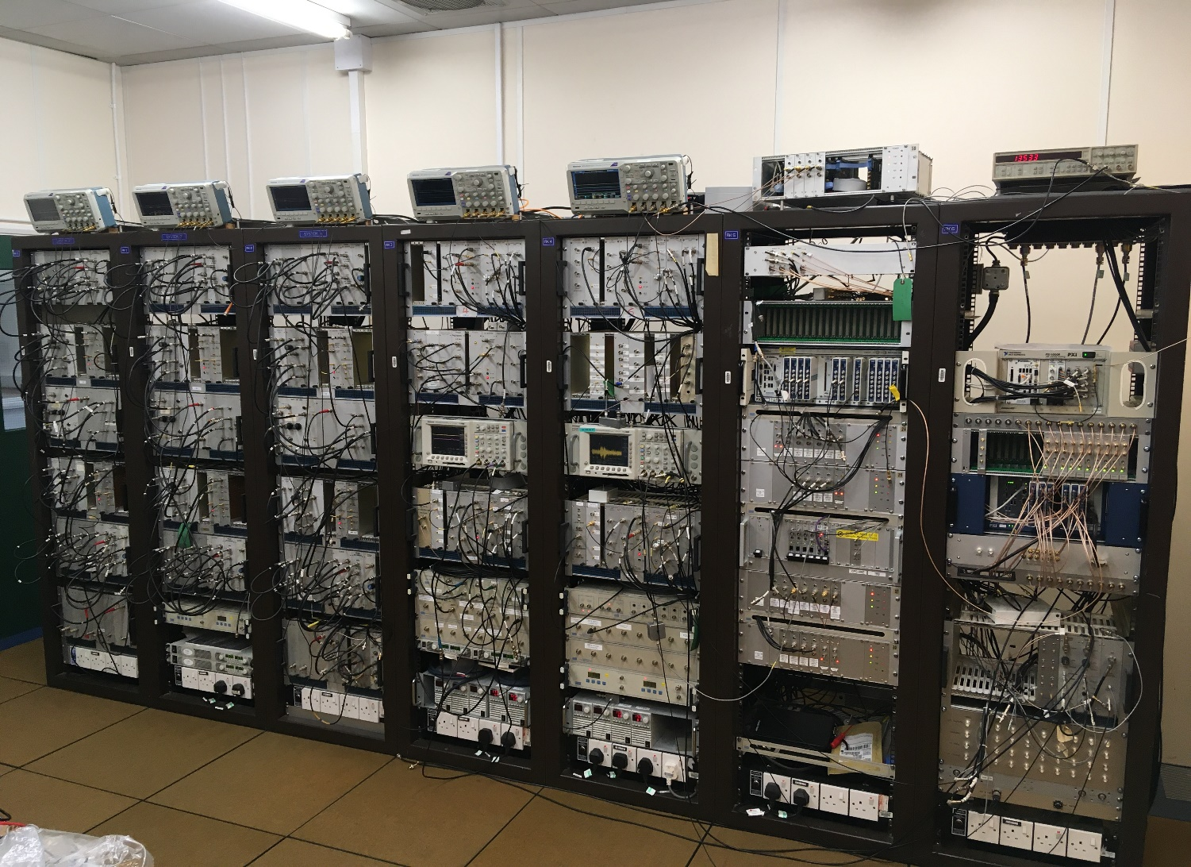
ISIS Synchrotron Digital LLRF Control System

Slide 7
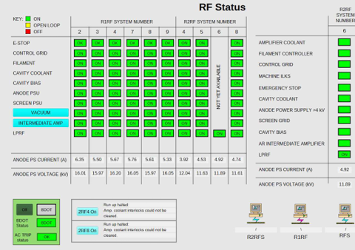
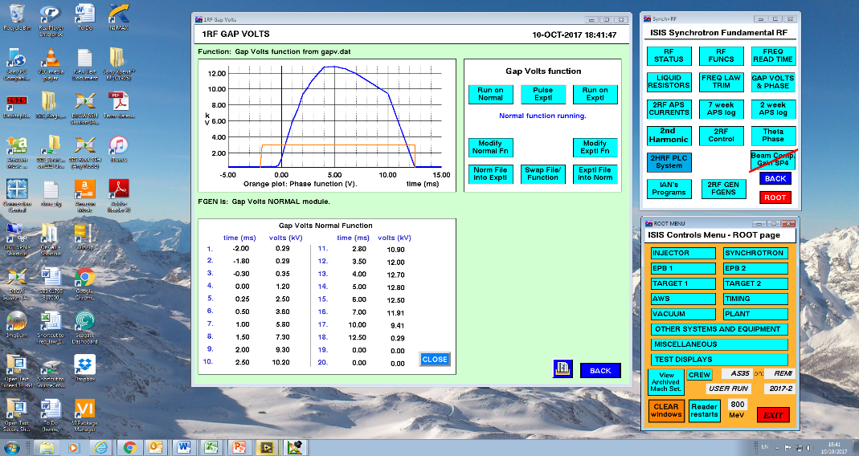
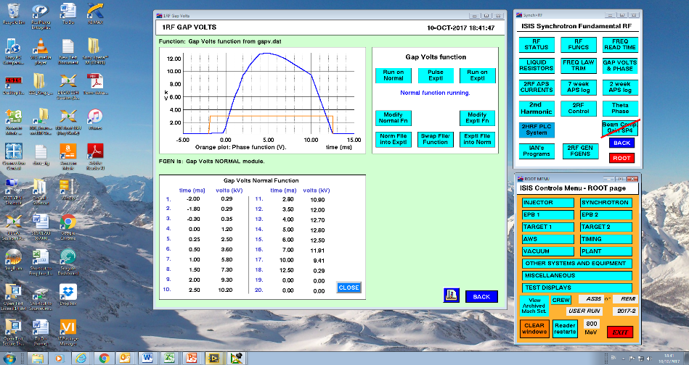

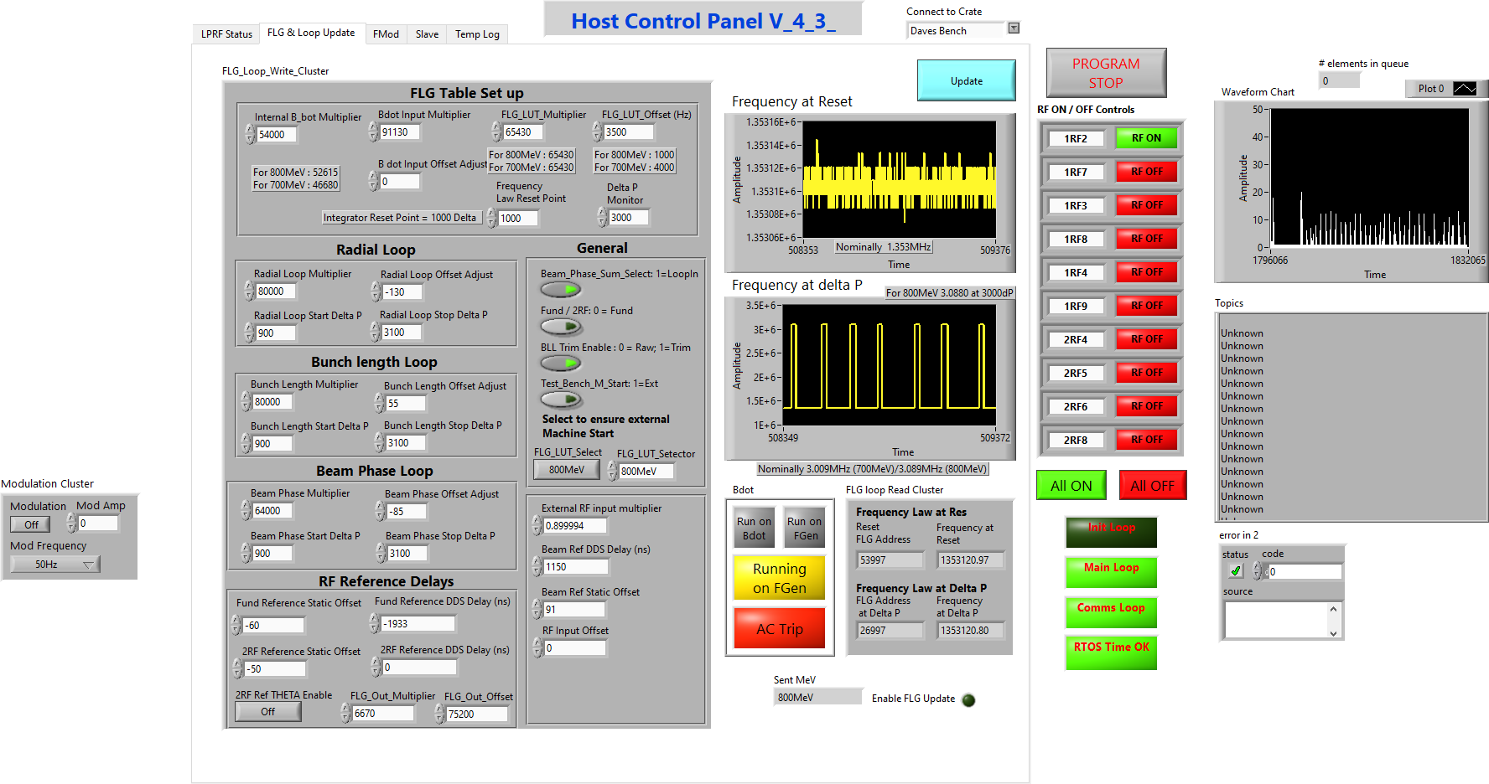
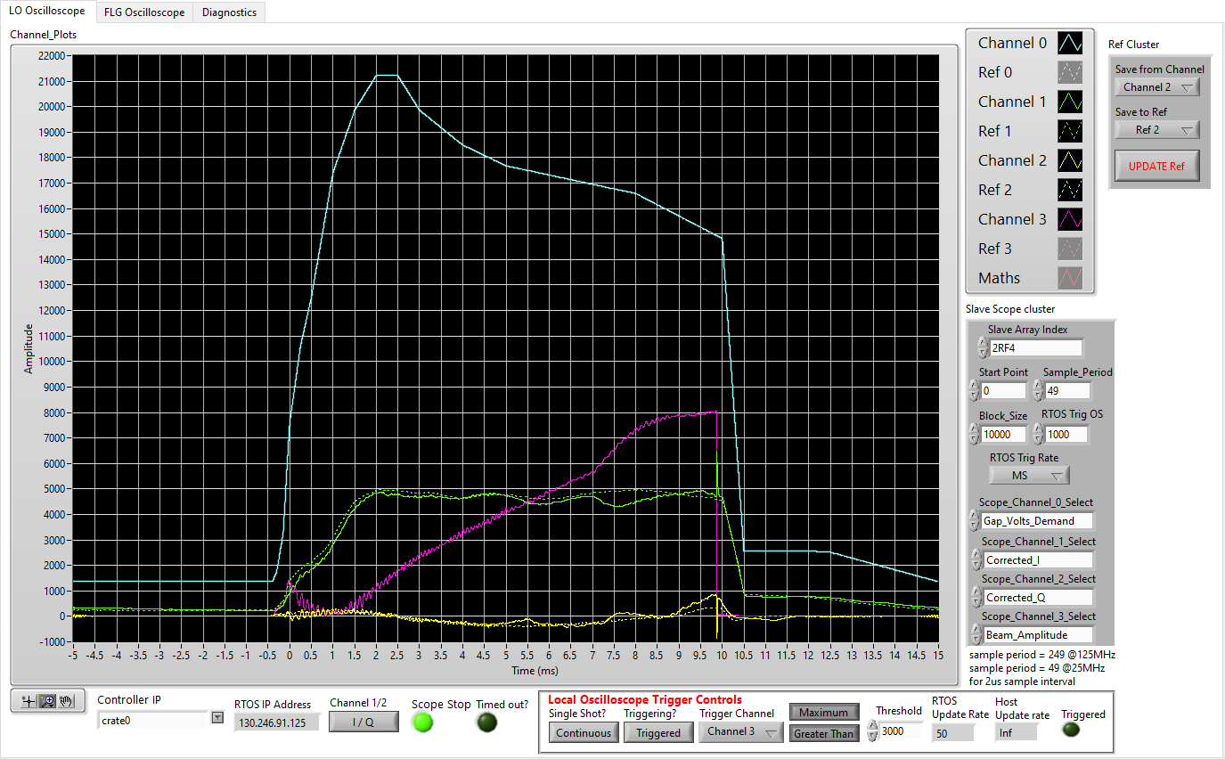
D-LLRF - System Architecture
EPICS Control
ISIS VISTA Controls system
Telegraf
MQTT Subscriber
To Influx
Data Archive
MQTT
Network Stream
NI PXIe Controller
FPGA Modules
PC Host Controls VI
PC Host Scope VI

Slide 8

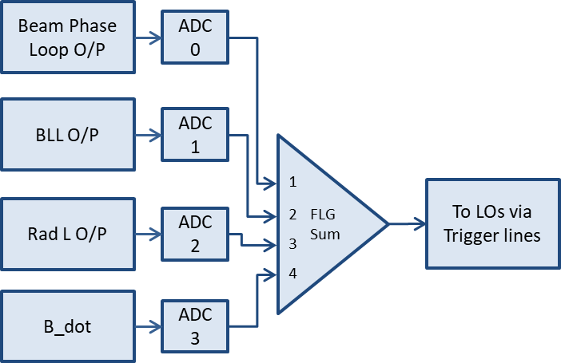
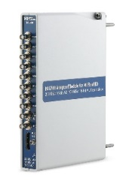
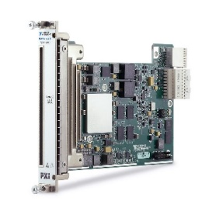
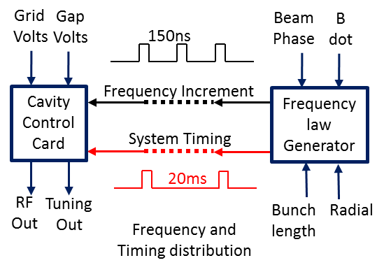
D-LLRF – Frequency Law Generator
Beam Loops
MMPS + FLG not perfect – so need a Radial Loop to help keep the beam in the middle of the pipe
Synchrotron motion leads to Beam phase oscillation – damped by Beam phase loop
Beam Bunch length loop no longer used (though spare input into ADC now used for digital BPL tests)
NI 5783 + NI 7971R
RF Synchronisation
Backplane trigger/data lines used for system timing, MS / GMS triggering (power saving) and frequency increment broadcast and synchronous update
NI PXIe-7971R: Kintex-7 325T FPGA

Slide 9
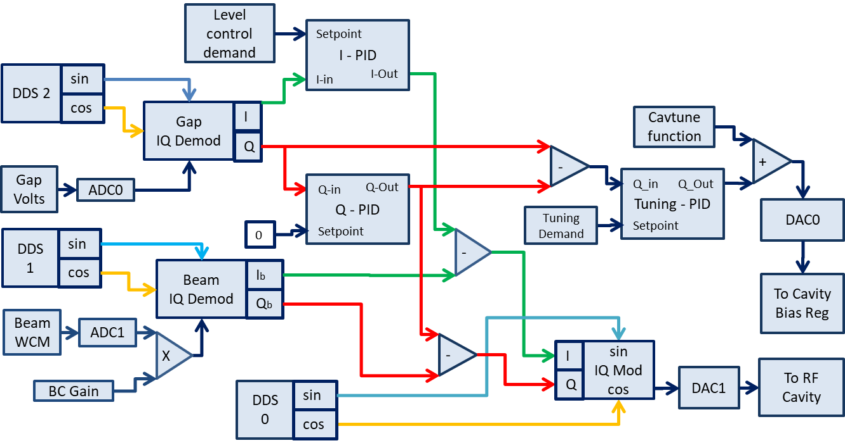
D-LLRF IQ loop and Cavity Tuning Loop
NI 5783 + NI 7971R
Digital – Q Error derived tuning
This tuning scheme was deployed in June 2025 and ran successfully with Beam during last two user cycles.
Allows non-zero tuning setpoint to detune cavity – eg beam loading during injection
Each FPGA / Transceiver Controls Gap Voltages on two Cavities
NI 5783: 4x ADC @ 200MS/s
4x DAC @ 100MS/s
x5

Slide 10
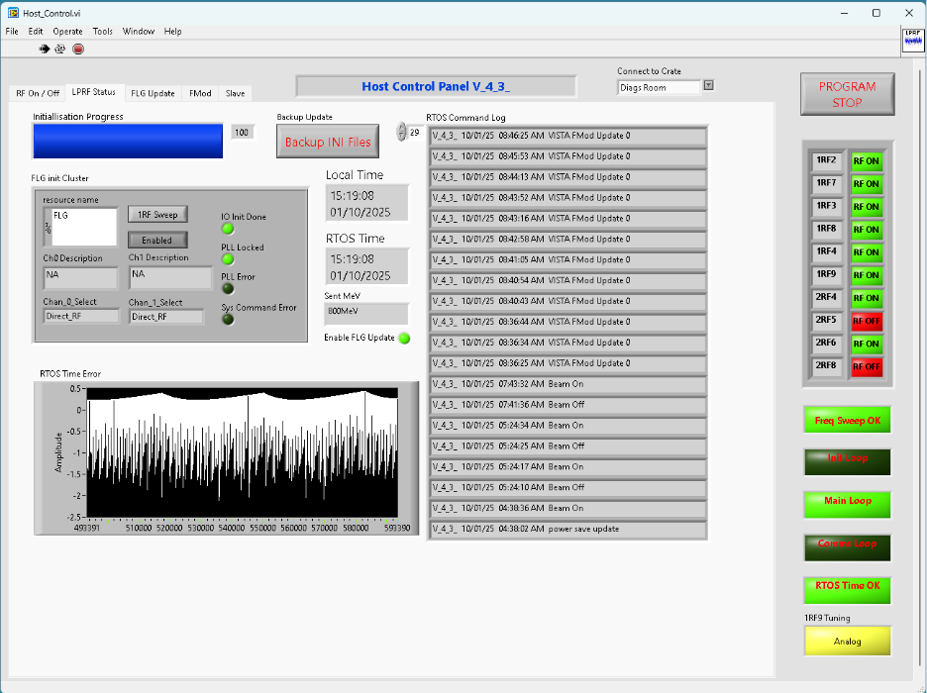
LLRF Control Screen

Slide 11
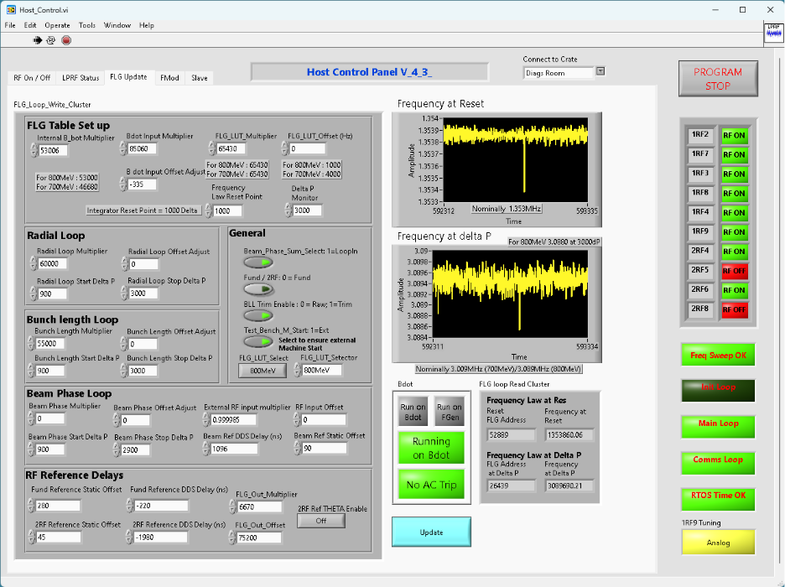
LLRF Control Screen

Slide 12
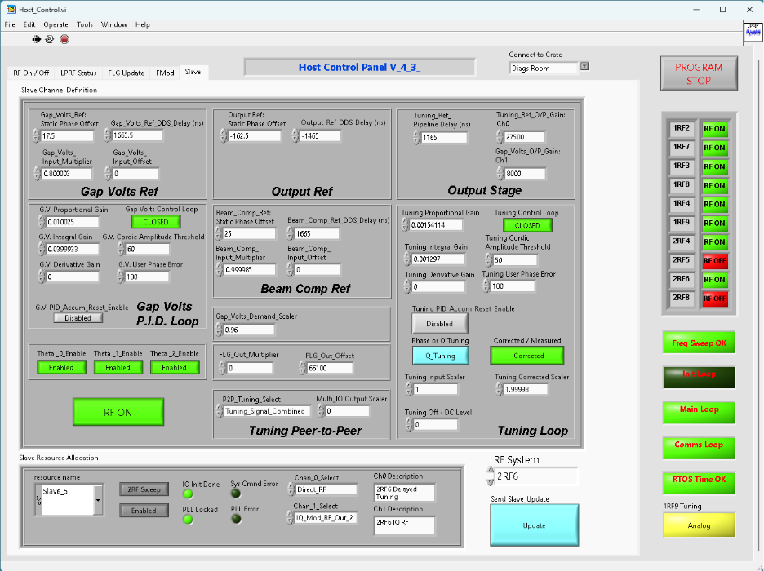
LLRF Control Screen

Slide 13
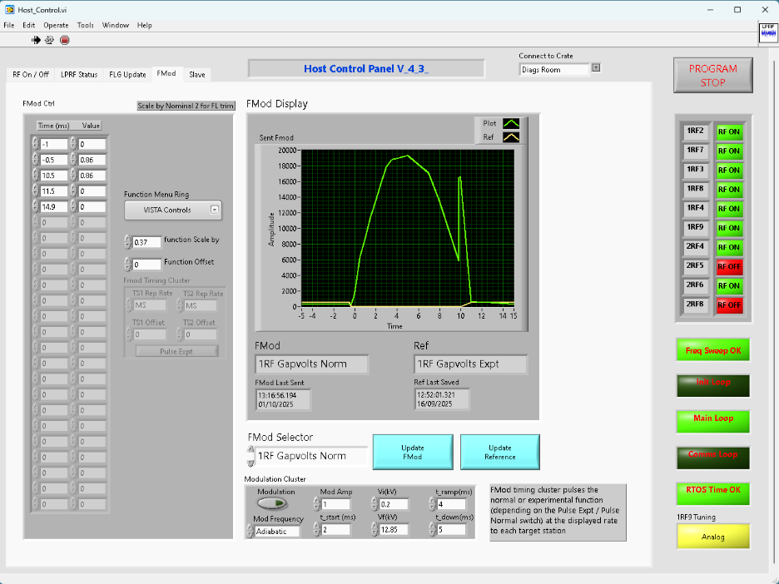
LLRF Control Screen

Slide 14
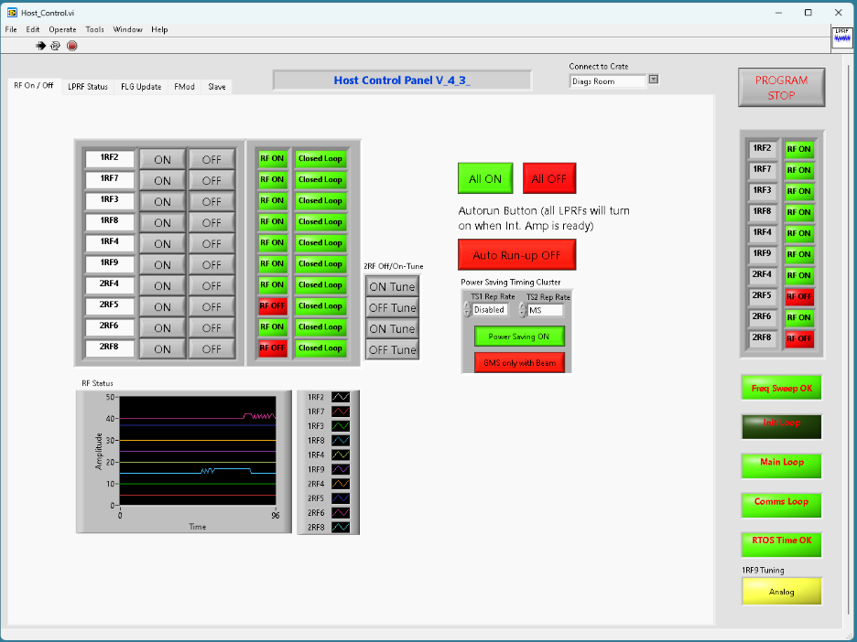
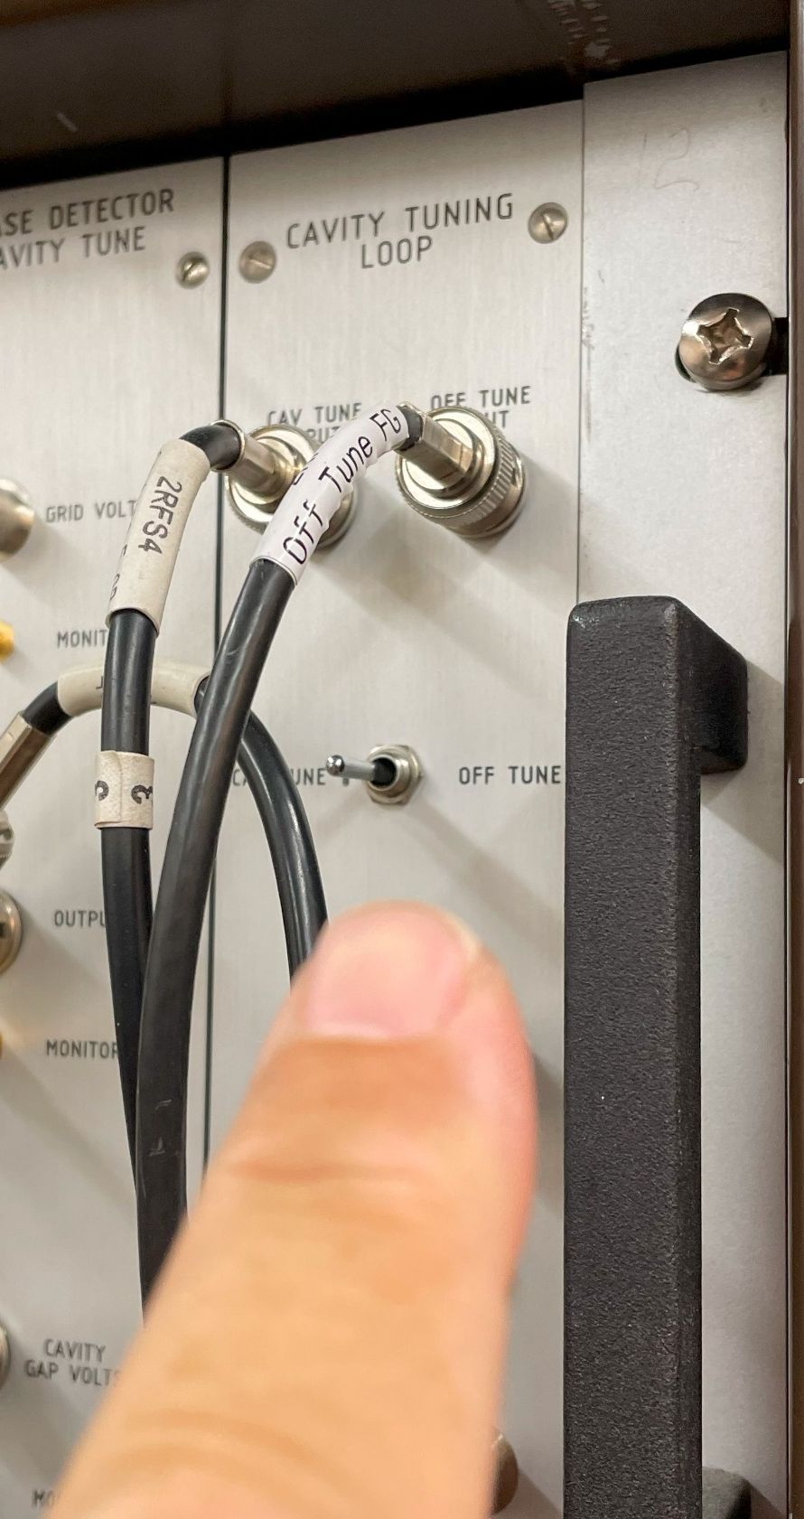
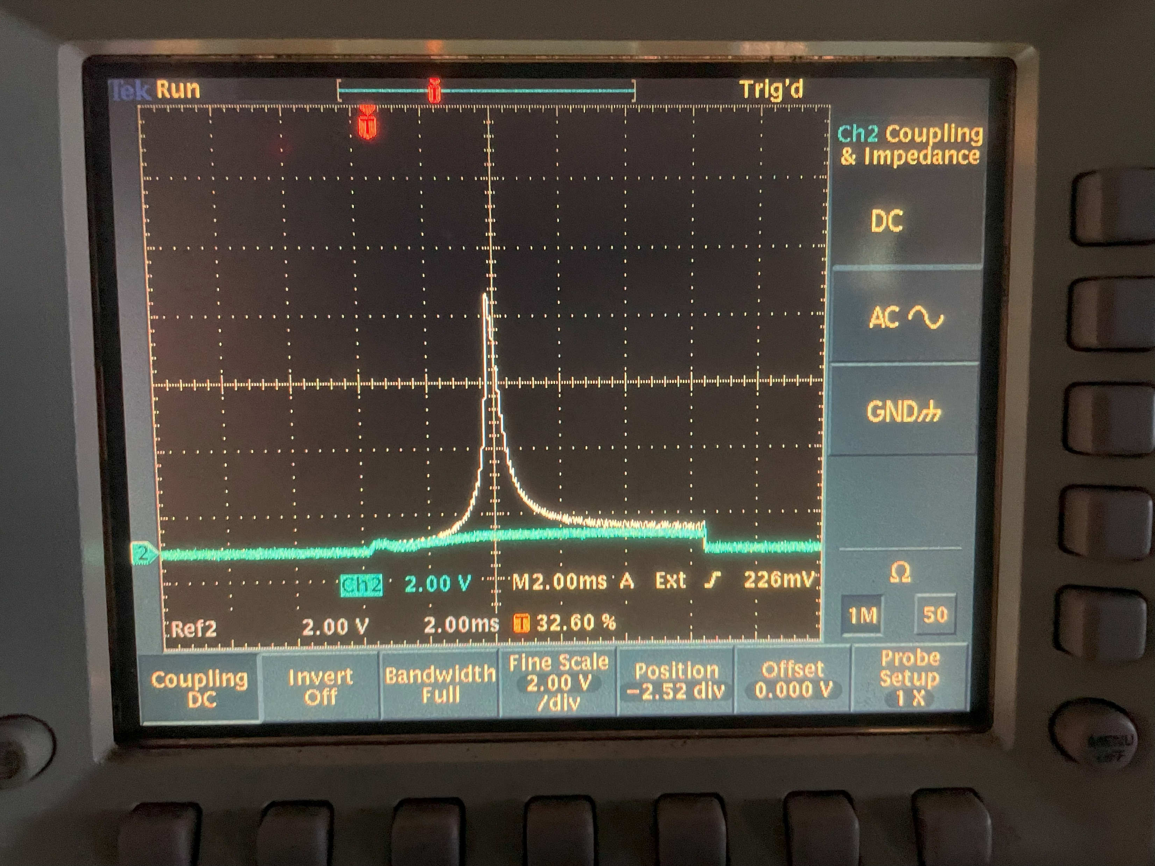
LLRF Control Screen
2RF cavity
On- tune / Off-tune Controls
Required when beaming with one or more 2RF cavities off
H=2 Component of beam passing through natural resonance of 2RF cavity with no bias demand gives large induced Gap Voltage
LLRF On / Off
Controls
Checks HPRF interlocks first
Power Saving
Timing Controls
Tuning is switched to open loop and “Off-tune” function is adjusted to minimise induced Voltage

Slide 15
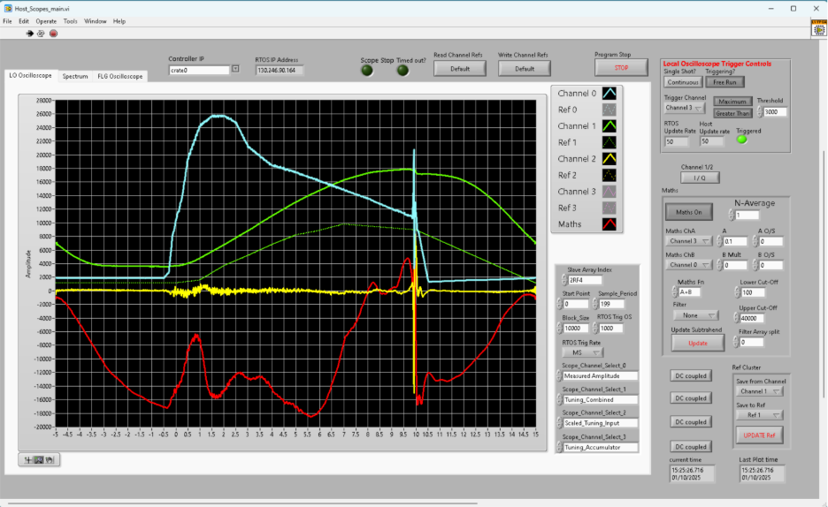
LLRF Digital Scope Traces
Measured Amplitude
Cavity Bias signal
Cavity Bias signal
(off-tune)
Q Tuning error
Scaled Tuning Accumulator

Slide 16
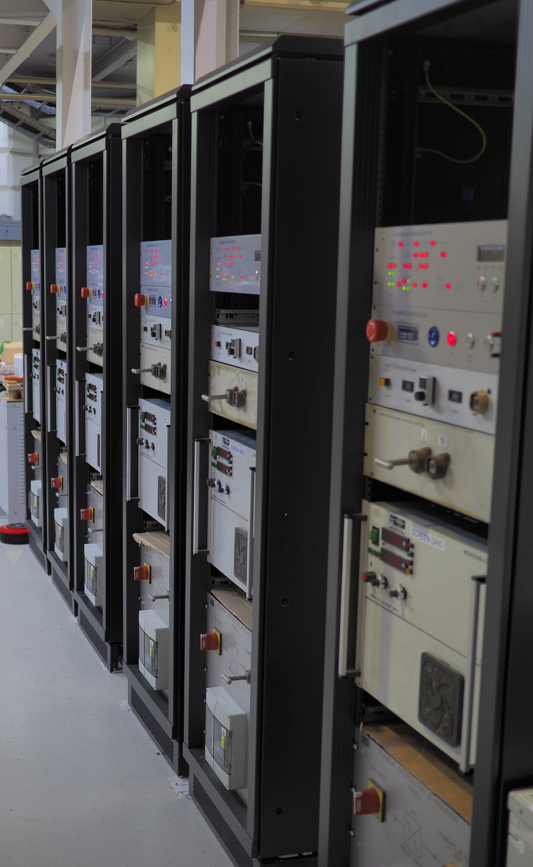
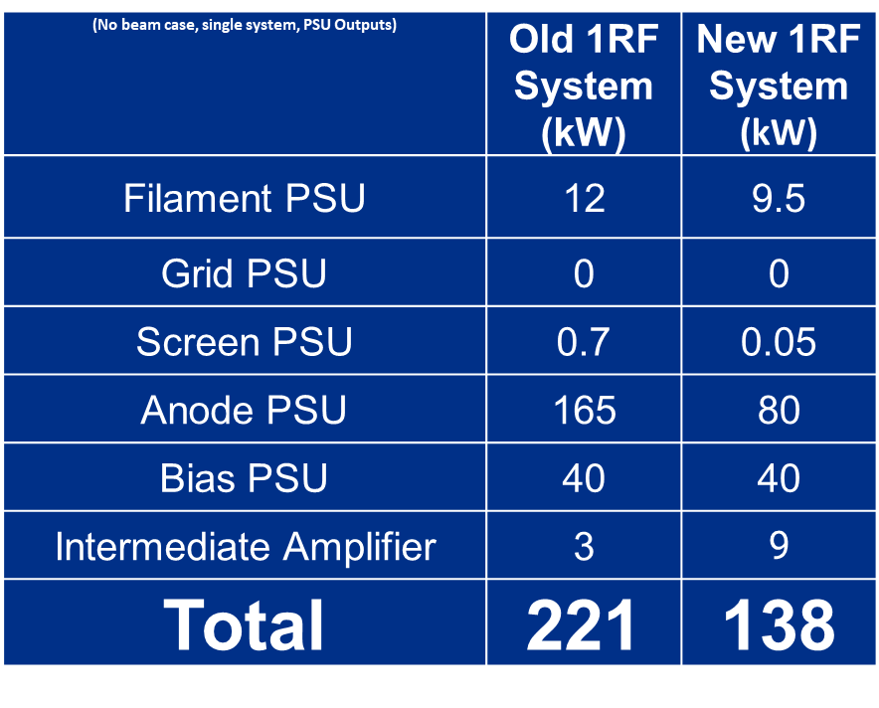
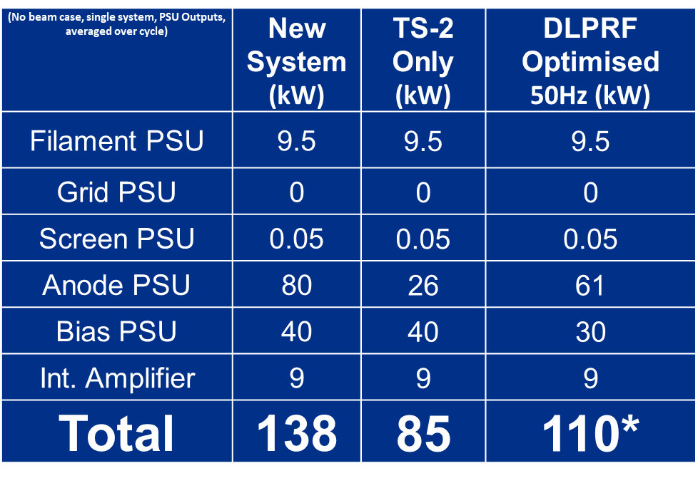
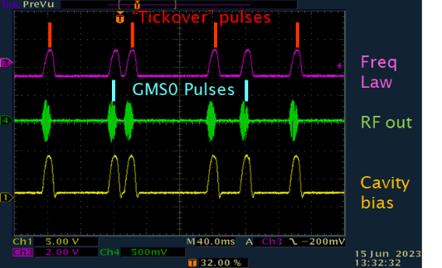
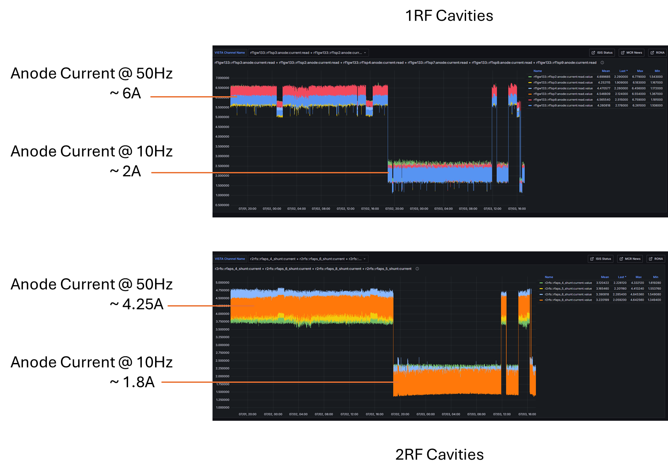
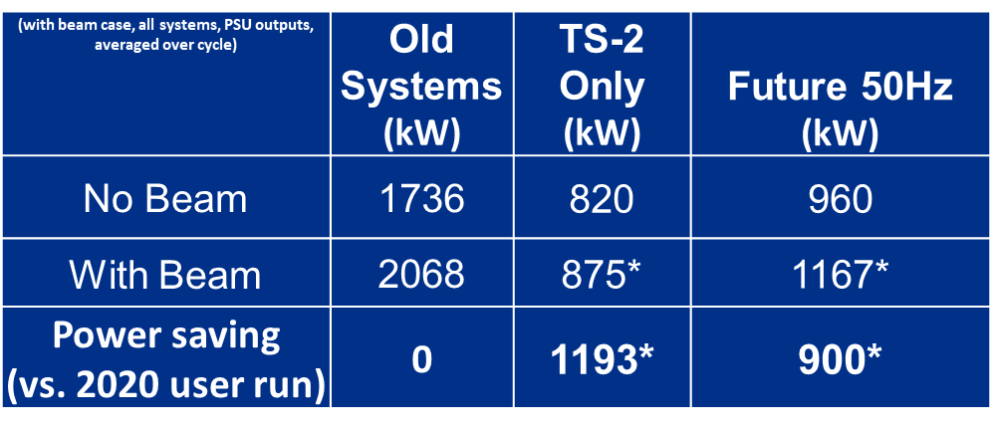
Power Saving
TH558 HPD Savings
Smart D-LPRF Savings
Total Savings
Internally generated timing allows different parameters for different cycles
D-LLRF system allowed RF-on trigger for TS1 or TS2 only, saving ~50kW / system for user run
Now only run full volts on GMS trigger only (i.e. for beam pulses only)
Long-term can also reduce bias power
In 2021-22 total RF System power for TS2 only operation were estimated to be reduced by ~ 1.2MW saving ~ £1million (23p/unit, 150 days running)
Once fully optimised and applied to cavity tuning, 50Hz running costs should be reduced by ~0.9 MW from pre-2020
Expertise developed for future design (e.g. ISIS-II)
Also reduces cooling plant power – not estimated here!
Comparing 25 user days in Nov - Dec 2023 with the same period in Nov – Dec 2020 showed an average reduction in the Anode Power of 550kW for the 1RF cavities alone.

Slide 17
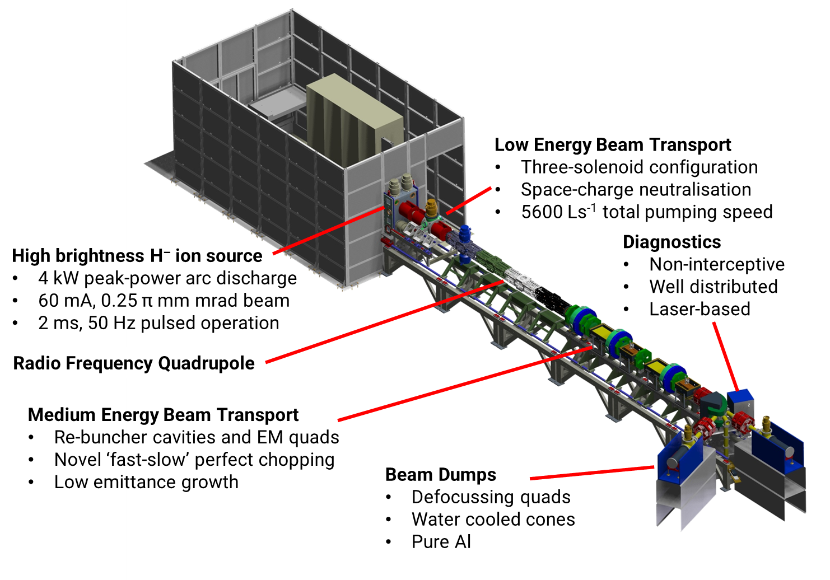










Front End Test Stand (FETS)
Motivation
FETS will demonstrate front end technologies for future high power proton drivers
High power ~ 20 kW @ 3 MeV => 1 MW @ 180 MeV
FETS is generic – many possible applications
Notes:
F

Slide 18
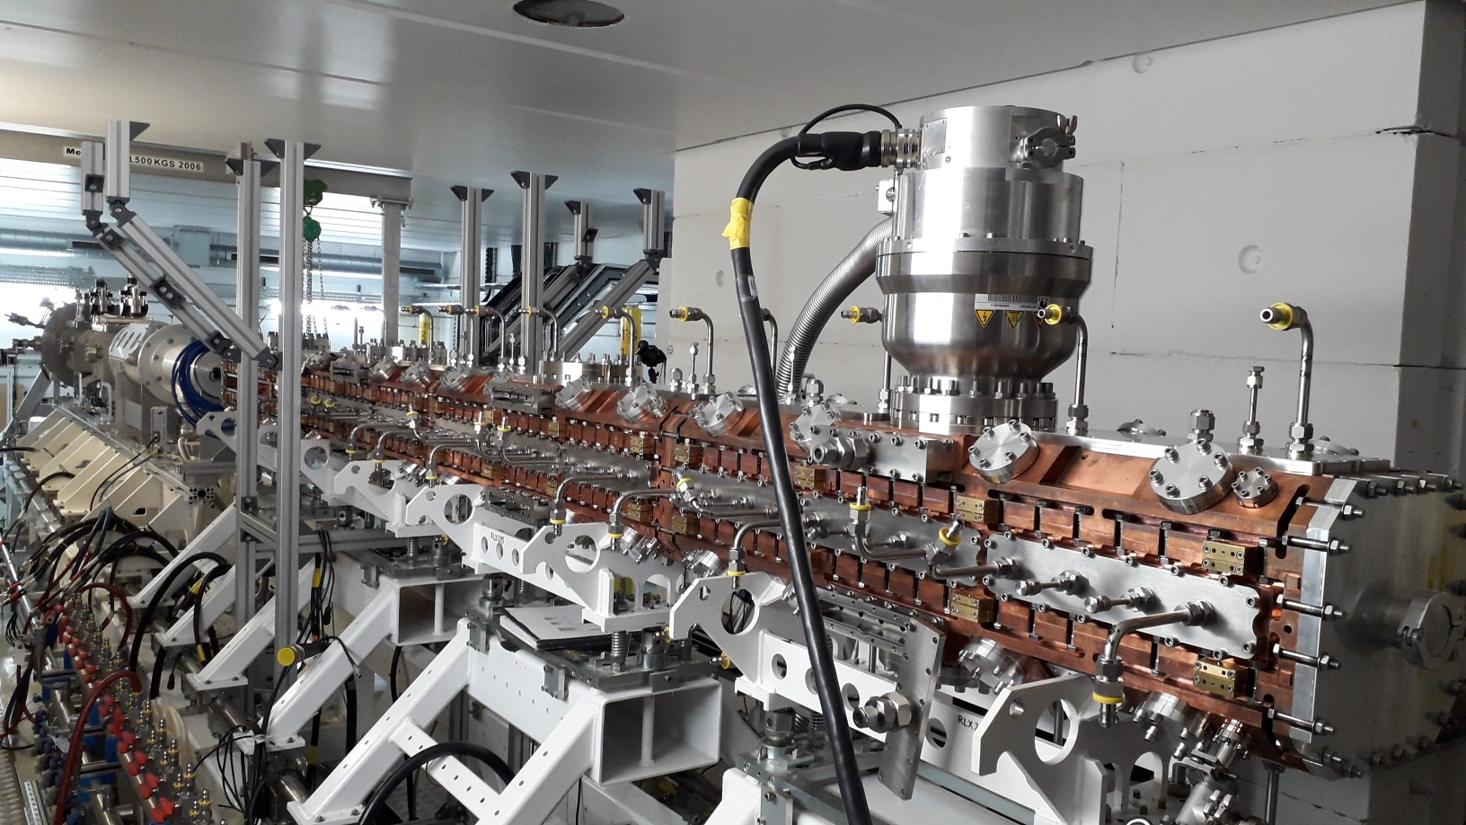
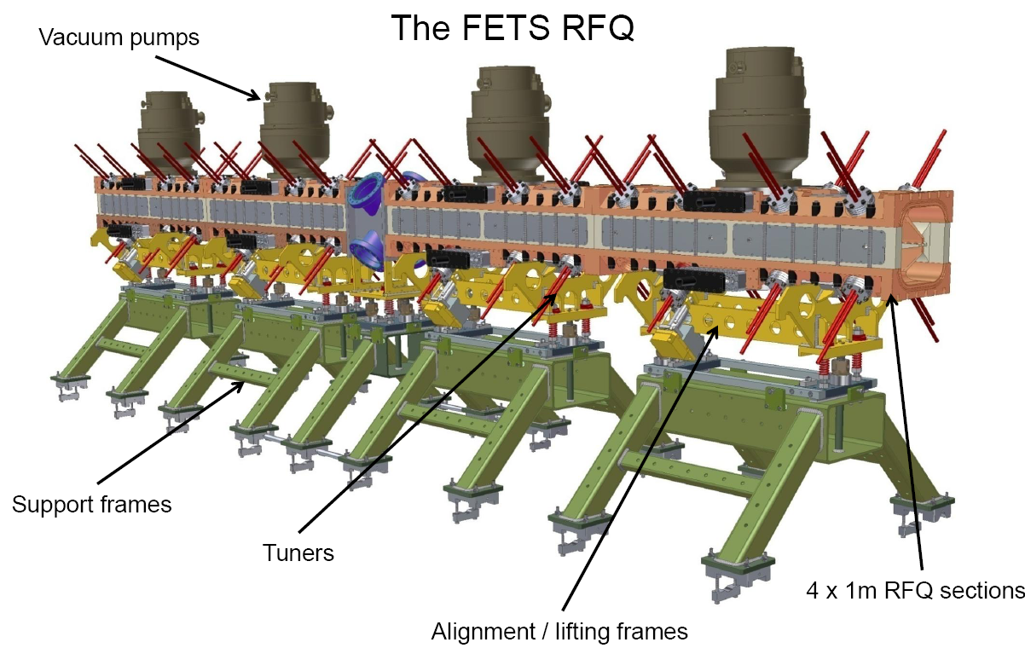
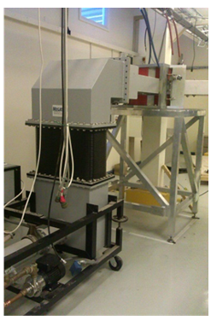

Front End Test Stand (FETS)
Radio Frequency Quadrupole (RFQ)
Four-vane, 324 MHz, 3 MeV
4 m bolted construction
High power efficiency
Powered by 1MW Klystron
Q~4000
Ion source, LEBT and RFQ commissioned with short beam pulses (200 μs) at low repetition rate (6.25 Hz)

Slide 19




MEBT
Front End Test Stand (FETS)
Re-bunching cavities:
Re-entrant type cavities
324 MHz, ~8 kW peak power
Q~10000
150 kV effective voltage
Copper plated stainless steel for lower cost
Dimensions and RF properties measured at various stages during
manufacture to achieve required performance.
8kW RF amplifiers

Slide 20





ISIS Pre-Injector upgrade
Q~ 2000
Q~ 5000
Pre-Injector Test Stand (PITS)
- Will run for ~1 year to test prior to installation on ISIS

Slide 21


FETS / PITS/ LINAC Digital LPRF Development
FETS
inherited hardware from initial design by ESS Bilbao
PITS
initial design used one FPGA / 12 Channel ADC + 1x24 channel Multifunction IO
tested successfully closed loop control for 1st QWR Cavity
but EOL shortly after first order! Also, concerns over backplane p2p latency to output multi-channel DAC.
so currently use same legacy Virtex 5 FPGA for FETS and PITS.
Benefits:
common analogue hardware - same FPGA / Transceiver as old Synchrotron LPRF - lots of spares
re-use LabView Synch LLRF project structure, controls interface, etc. to both FETS and PITS projects
almost same FPGA code apart from different subsampling clocks for 324MHz (FETS) and 202.5MHz (PITS) + Change of output filter for IQ Modulator
Problems with legacy FPGA modules:
not supported in LabView 2023+ and Virtex 5 FPGA module incompatible with Linux RT PXI controllers
Virtex 5 code development using Xilinx ISE not supported for Windows 10+ and IT will not allow a Windows 7 machine on our network!

Slide 22




FETS / PITS/ LINAC Digital LPRF Development
FETS / PITS D-LLRF System block diagram
Example below is PITS RFQ controller
PID loop open / closed / gated
Loop Controls on Host PC
250MHz Input sampling.
FETS: Divide by 7-> 35.7MHz Clocking
PITS: Divide by 5 -> 50MHz Clocking

Slide 23

FETS / PITS/ LINAC Digital LPRF Development
PID loop Control Host.VI on control PC
Initial Tests: FETS RFQ With Beam (July 2025)
Field Demand, Open loop / closed loop Field level
Required +/-1%
Beam Inj.
PID coefficients
loop gate timing
Solid State amp: On Off
Tetrode amp: On Gating Sequence Off
LLRF IQ loop: On Off
accumulator pre-load level / accumulator wrap
Closed loop level control response already not bad
– MEBT Beam Chopping at later stage may remove beam from initial field “dip”
Hope to utilise Feedforward to reduce beam loading to within acceptable level

Slide 24






FETS / PITS/ LINAC Digital LPRF Development
Legacy FPGA systems OK for test system, but not on operational ISIS Injector System
During lifetime of PITS, will also develop alternate approach (Analog IQ Demod / PID Controller / Analog IQ Modulator) and compare performance
Much simpler /more cost-effective option
will work for both FETS and PITS frequencies
Longer Term
ISIS Controls Group Currently looking at µTCA-4 for some systems
Use same manufacturer / crates / firmware Libraries??
Allows us to re-visit Digital IQ demodulator for Injector ( + RCS?+ ISIS II?)

Slide 25


Summary / Status / To do
PITS
Initial D-LLRF Tests on RFQ Without beam
Similar Field control response to FETS system
But – noticed huge variation in measured IQs due to induced signal in LLRF cabling – 4616 very noisy!
Recent beam tests through RFQ with analogue field stabiliser also prone to random trips
LLRF testing awaiting move of 4616 Tetrode into ‘Lead shed’
Synchrotron D-LLRF
Nearing completion
Further work on cavity tuning – fully characterise tuning loop response
Still to implement digital beam phase - loop IIR filter!
Will need to interface to new EPICS control system as it comes online
FETS
Have re-structured “F-Mod” timing to reflect shorter timescale for injector
Not yet tested as RFQ Modulator has recently failed – awaiting diagnosis and repair!
Interim - Move onto Recirculating cavity tests?
Best bet for soonest beam tests? – So develop PITS / FETS FFBC here?
FFBC?

Slide 26









Acknowledgements
Huge Team Effort: but, in particular, thanks to Dave Allen
Thanks to Nadir Bouhelali, Alan Letchford and Olli Tarvainen for slides / technical input
References
“New PXIe-Based LLRF Architecture and Test Bench for Heavy Ion Linear Acceleration” Badillo et al, 19th IEEE-NPSS Real Time Conference 2014.
“Status of the RAL Front End Test Stand” Letchford et al, IPAC 2015.
“The Pre-Injector Upgrade for the ISIS H− LINAC” Lawrie et al, LINAC 2022.
“Status of the ISIS Synchrotron Digital LLRF System” Seville et al, LLRF 2022.

Slide 27
Thanks for listening!

